Slide 1
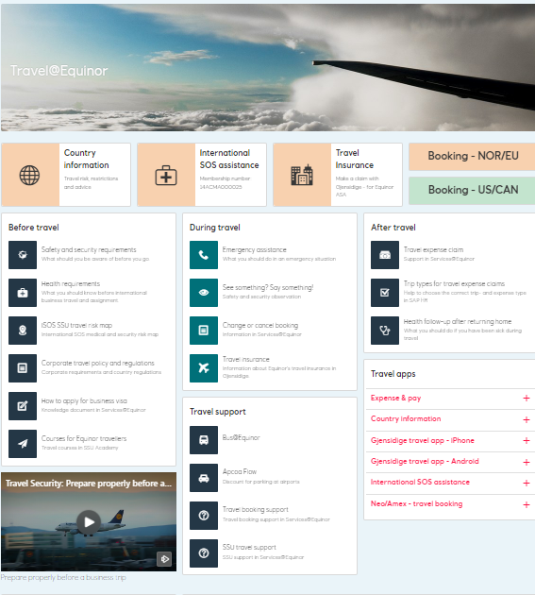
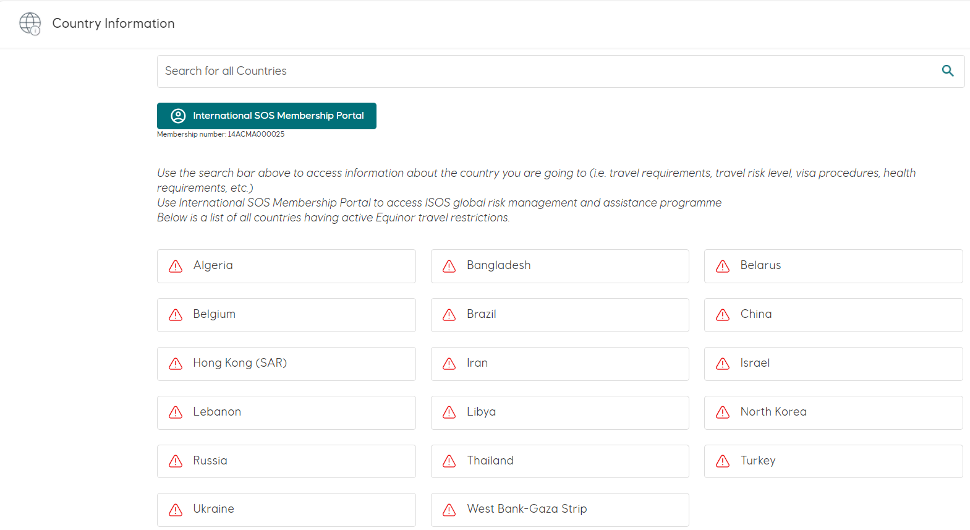
Travel Risk Management in Equinor
Equinor Definition of Travel Risk
Identify Travel Risk
Manage Travel Risk
Scope
Focus Areas
Travel@Equinor portal
Equinor Country Information portal

Slide 2
Equinor Definition of Travel Risk
‘Identify and manage travel HSE risks to Equinor business travelers’:
‘Risks to business travelers’
All HSE risks – security, safety, HWE
≠ Travel Management
‘Shared service approach’
Travel Risk Manager (1 FTE)
Part of Equinor Emergency Response
Dependent on HR resources
‘Duty of Care’ vs. ‘Duty of Loyalty’ / ISO31030
Travel@Equinor
Travel@Equinor portal

Slide 3
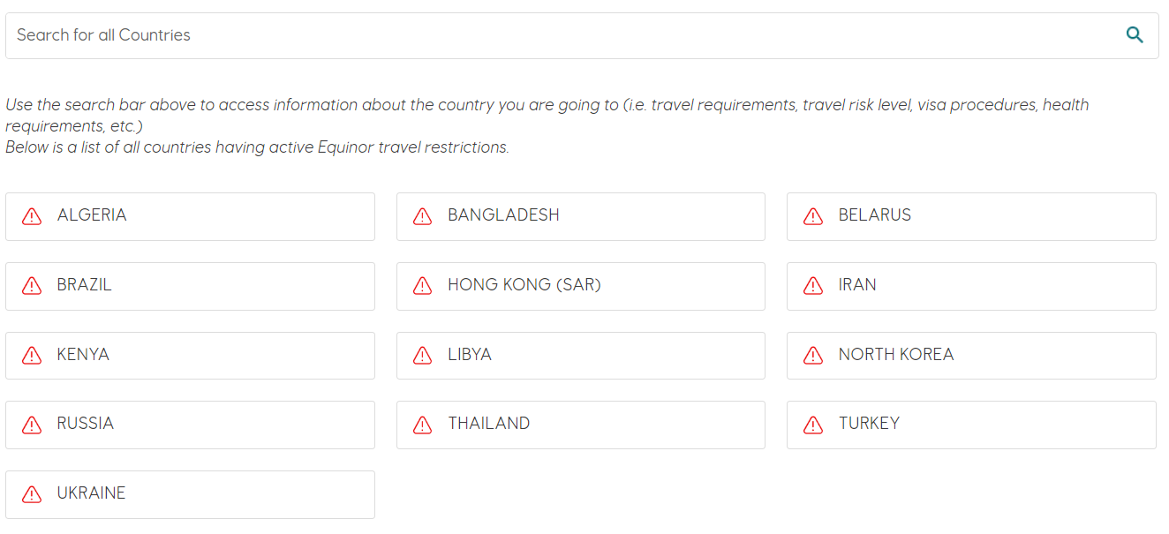
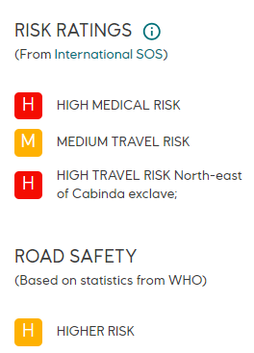
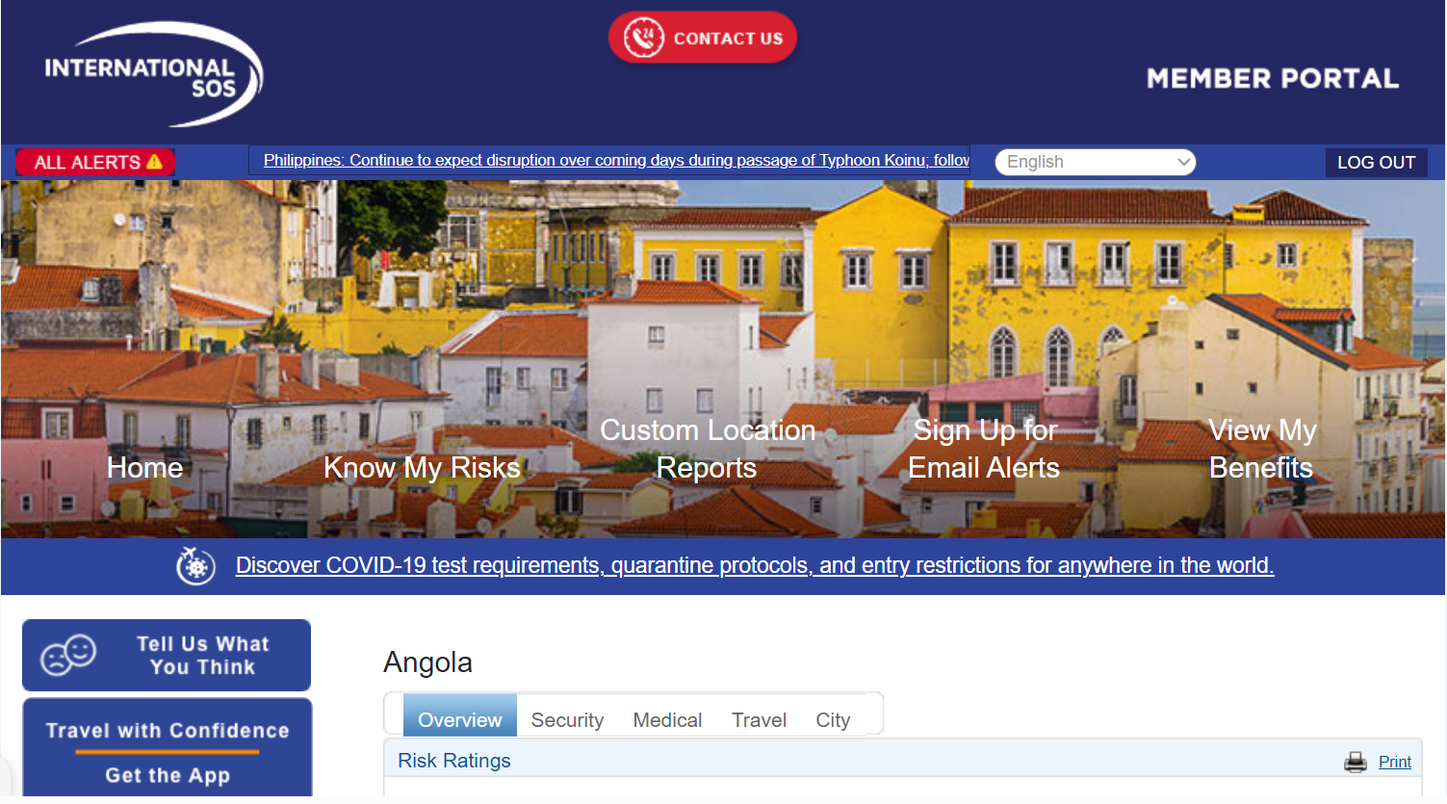
Identify Travel Risk
Travel@Equinor
Country Information pages
Travel risk level
ISOS Country Information portal
-------------------------------------------------
HSE for Hotel, flight and rental cars
Travel insurance
Government advice
Equinor Country Information portal
Travel@Equinor portal
ISOS Country Information portal
Travel risk level

Slide 4
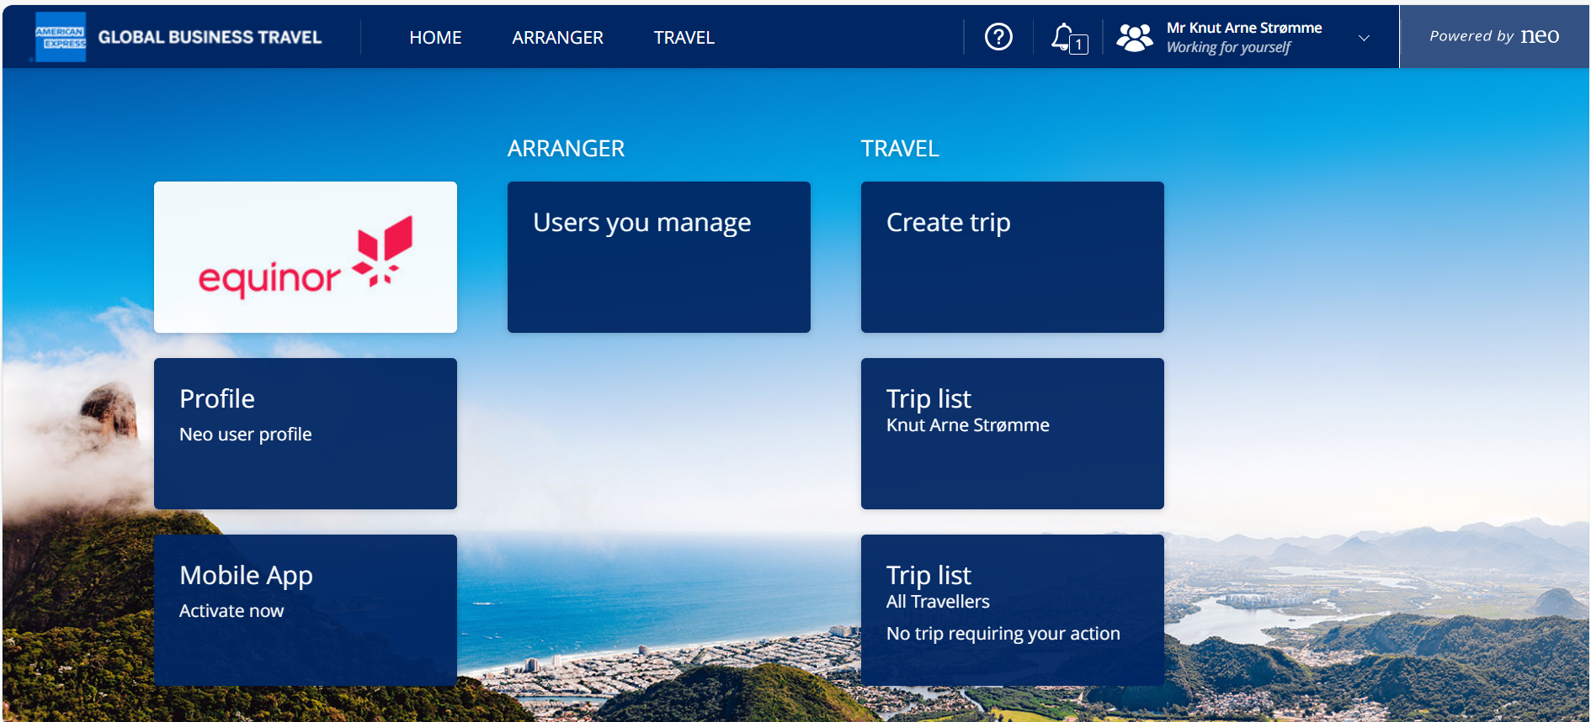
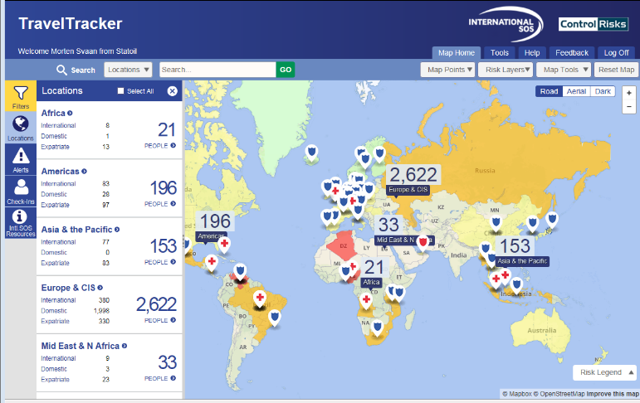
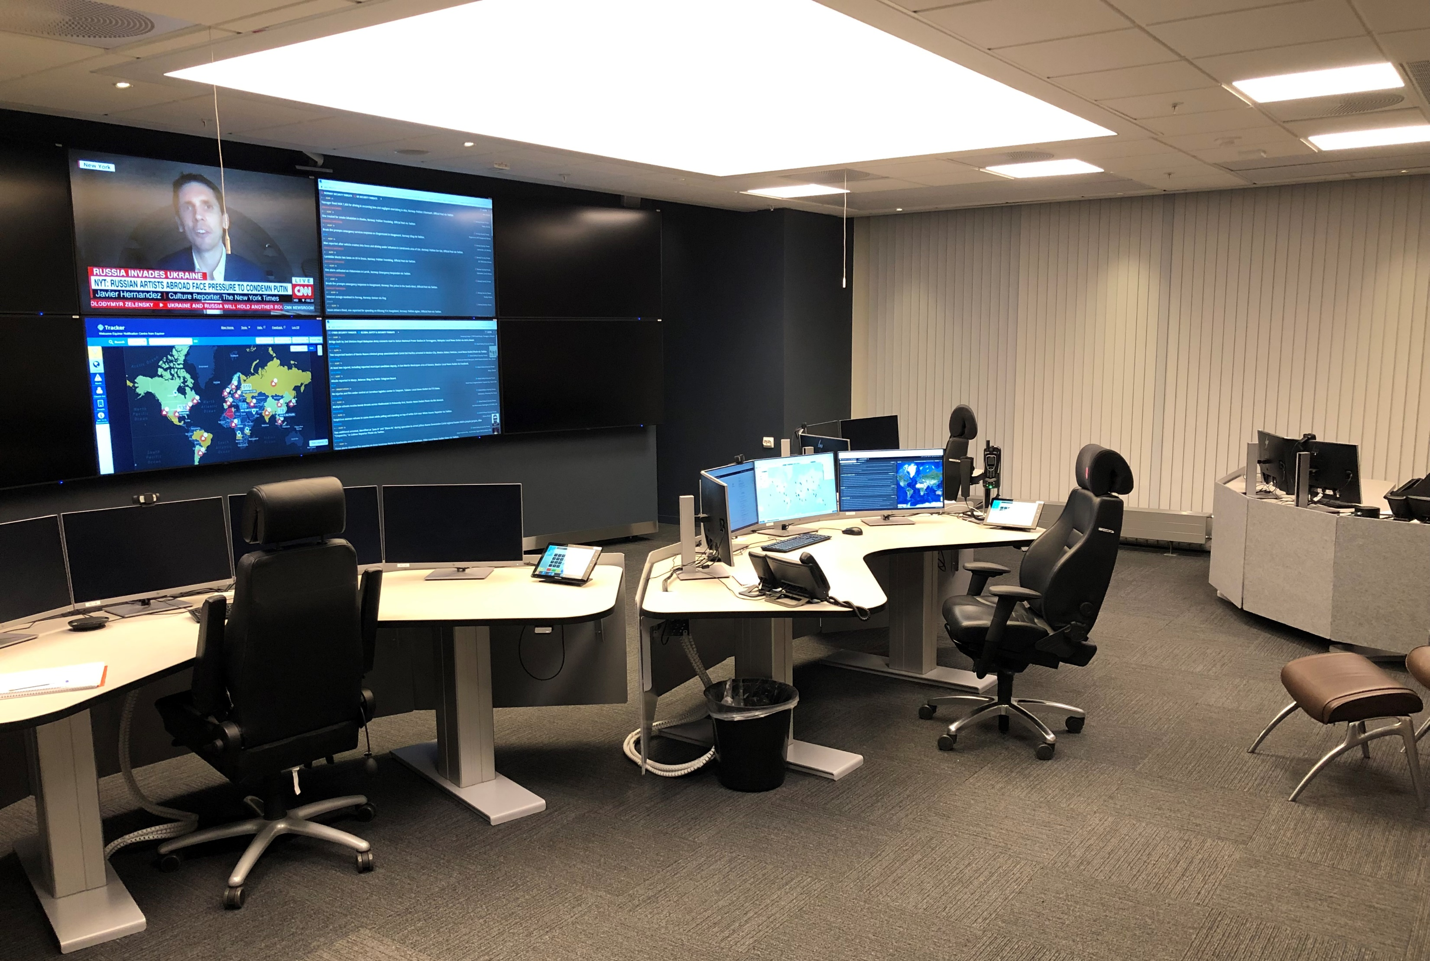
Manage Travel Risk
Travel@Equinor
Before travel
During travel
Travel agency – (ASA: Amex GBT/NEO)
ISOS Travel Tracker
Pre Trip Advisory
Travel alerts
Travel insurance – (ASA: Gjensidige)
Emergency response
RSC / IMT / G-IMST
Advice & support
Amex GBT Neo portal
Travel@Equinor portal
Travel Insurance
ISOS Travel Tracker
Equinor Response & Support Center

Slide 5
Travel Risk – Scope and Complexity
Before travel
During travel
After travel
Preparation
- Health check
- Vaccines
- Medical kit
- Security kit
- Satellite phone
- Visa procedures
- Valid passport
- Insurance coverage
- Risk Assessment
- Next-of-kin/contact details
- Insurance coverage
- General TRM training
- Customized briefings
- JMP
- Essential contacts
- Pre-trip advisory
- Flight safety
Booking
- Hotel
- Rental car
- Flight
- Ground transport
- Travel Policy
Travel
- Real-time advisory
- Real-time reporting
- Update/change booking
- Meet-and-greet
- Executive protection/security
- Tracking /detailed route, itinerary/technology
- Vetted accommodation
- Insurance
Return
- Debriefing
- Post travel health check
- Insurance
- Reimbursement
- Hand-in travel kits
Incident
- Insurance
- Crisis management
- Emergency response
- Advisory

Slide 6
Focus Areas
Risk based approach
Holistic approach
User focus
Improve Journey Management Plan (JMP) process
Focus on reporting

Slide 7
Questions?
Knut Arne Strømme Travel Risk Manager FCOE SSU SCC RSC Equinor ASA +47 97749898 knstro@equinor.com Visitor address: Forusbeen 50, Forus, Norway equinor.com

