Slide 1

Compliance
Oslo 7.3.2012
Petra Metsola
Category Manager Travel
Wärtsilä Supply Management
Best Travel Policy Compliance Programme

Slide 2


This is Wärtsilä
SHIP
POWER
POWER
PLANTS
SERVICES
2 © Wärtsilä

Slide 3
Net sales by business 2011
Ship Power
24% (26)
Power Plants
32% (34)
Services
43% (40)

Slide 4
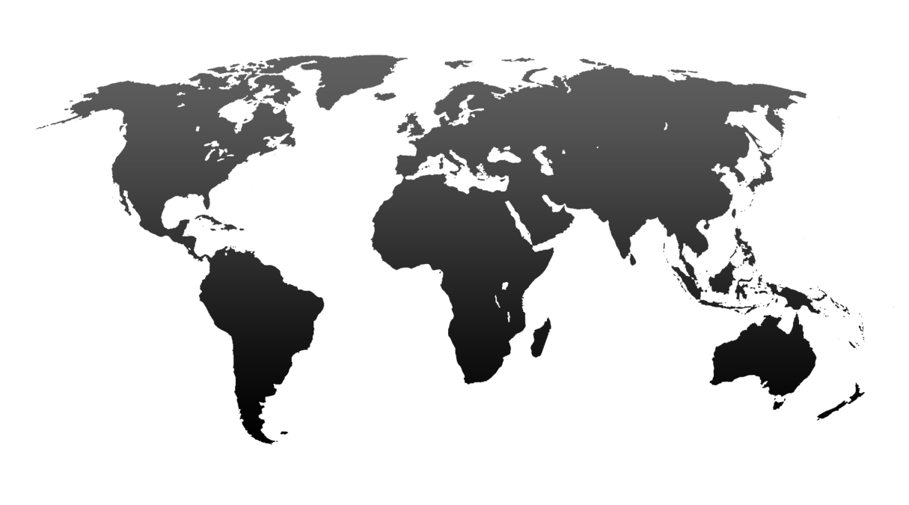
Wärtsilä Services
→ 70 countries → 160 locations → 11’000 people → 7’500 field service forces
We are the only player in the market able to offer our clients 24/7 support, globally,
in the fields of logistics, technical support and field service from a single source.
4 © Wärtsilä

Slide 5
Net sales by market area
Asia represents nearly 40% of net sales
MEUR
Asia
Europe
Americas
Other

Slide 6
Net sales by country
Top 10 countries as a percent of 2011 net sales
Country | % of net sales
China | 9%
Turkey | 6%
Norway | 5%
USA | 5%
the Netherlands | 4%
Brazil | 4%
Dominican Republic | 3%
Singapore | 3%
Bangladesh | 3%
South Korea | 3%

Slide 7
Power Plants order intake
Good global spread
Europe 788 (762)
Asia 1,055 (1,346)
105
422
219
821
Americas 713 (745)
261
15
102
79
211
Africa and Middle East 784 (321)
322
Flexible baseload
Industrial self-generation
Oil & gas
Grid stability & peaking
261
523
Order intake 2011: 3,340 MW (3,175)

Slide 8
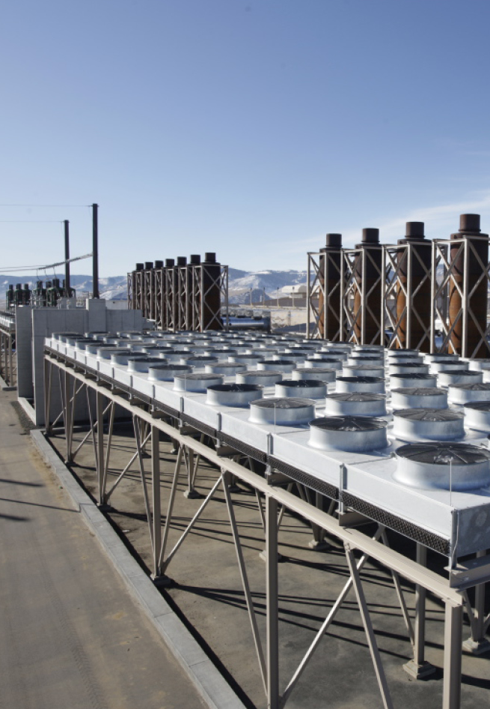
2011 – Growth in order intake, resilience in profitability
Order intake EUR 4,516 million, +13%
Joint venture order intake EUR 394 million (77)
Net sales EUR 4,209 million, -7.6%
Operating result EUR 469 million,
11.1% of net sales
Cash flow EUR 232 million (663)
EPS EUR 1.52 (1.68)
Dividend proposal 0.90 euro per share (1.75)
Acquisition of Hamworthy expected to become effective 31 January 2012
Operating result and EPS are shown excluding nonrecurring items.

Slide 9

Our mission, vision, and values
Mission
We provide lifecycle power solutions to enhance the business of our customers, while creating better technologies that benefit both the customers and the environment.
Vision
We will be the most valued business partner of all our customers.
Values
Energy – Capture opportunities and make things happen
Excellence – Do things better than anyone else in our industry
Excitement – Foster openness, respect and trust to create excitement

Slide 10
Global Travel spend development 2006-2011
The increasing spend trend has settled
Compliance gates

Slide 11
Global travel figures
11 000+ travellers (Total global numbers of employees 18 000)
133 000+ Travel Reports
87 000+ Air Tickets
250 000+ Hotel Nights

Slide 12
Global Travel Management in Wärtsilä
Service
Power
Plants
Ship Power
WIO
Support
functions
Group Travel Policy
and local quidelines
Supplier agreements: airlines, hotels, car rental etc…
Reporting
Tools and
suppliers
Security
Spend
Supplier analysis
Amex payment solution
BCD Travel
www.hotel.info/wartsila
Travel Expence Handling Process
(SAP HR/Travel Module)
Costs
Compliance

Slide 13
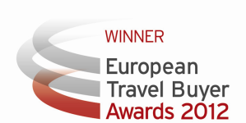
Compliance gate keepers, Wärtsilä in Europe
Volume
Countries
Gate 1
Approvals
Gate 2
Purchasing
(BCD Travel agency)
Gate 3
Data
Gate 4
Verification
Finland
Netherlands
Norway
Switzerland
Italy
France
Sweden
Great Britain
Denmark
Germany
Cyprus
93%
WTC
Travel Request
SAP
WSSC
ES
PL
TK
Spain
Poland
Turkey
Greece
Portugal
Hungary etc.
GR
PR
HU
7%
WTC
= Wärtsilä Travel Center, an implant office of the travel agency (BCD Travel) handling 93% of the bookings.
Other Wärtsilä countries are served by local BCD Travel office.
WSSC
= Wärtsilä Shared Service Center that checks all the travel reports globally.

Slide 14
Compliance gate keepers, Wärtsilä Global
Volume
Countries
Gate 1
Approvals
Gate 2
Purchasing
(BCD Travel agency)
Gate 3
Data
Gate 4
Verification
Finland
Netherlands
Norway
Switzerland
Italy
France
Sweden
Great Britain
Denmark
Germany
Cyprus
60%
WTC
Travel Request
SAP
WSSC
ES
PL
TK
Spain
Poland
Turkey
Brazil
USA
Singapore etc.
BR
US
SG
40%
WTC
= Wärtsilä Travel Center, an implant office of the travel agency (BCD Travel) handling 93% of the bookings.
Other Wärtsilä countries are served by local BCD Travel office.
WSSC
= Wärtsilä Shared Service Center that checks all the travel reports globally.

Slide 15
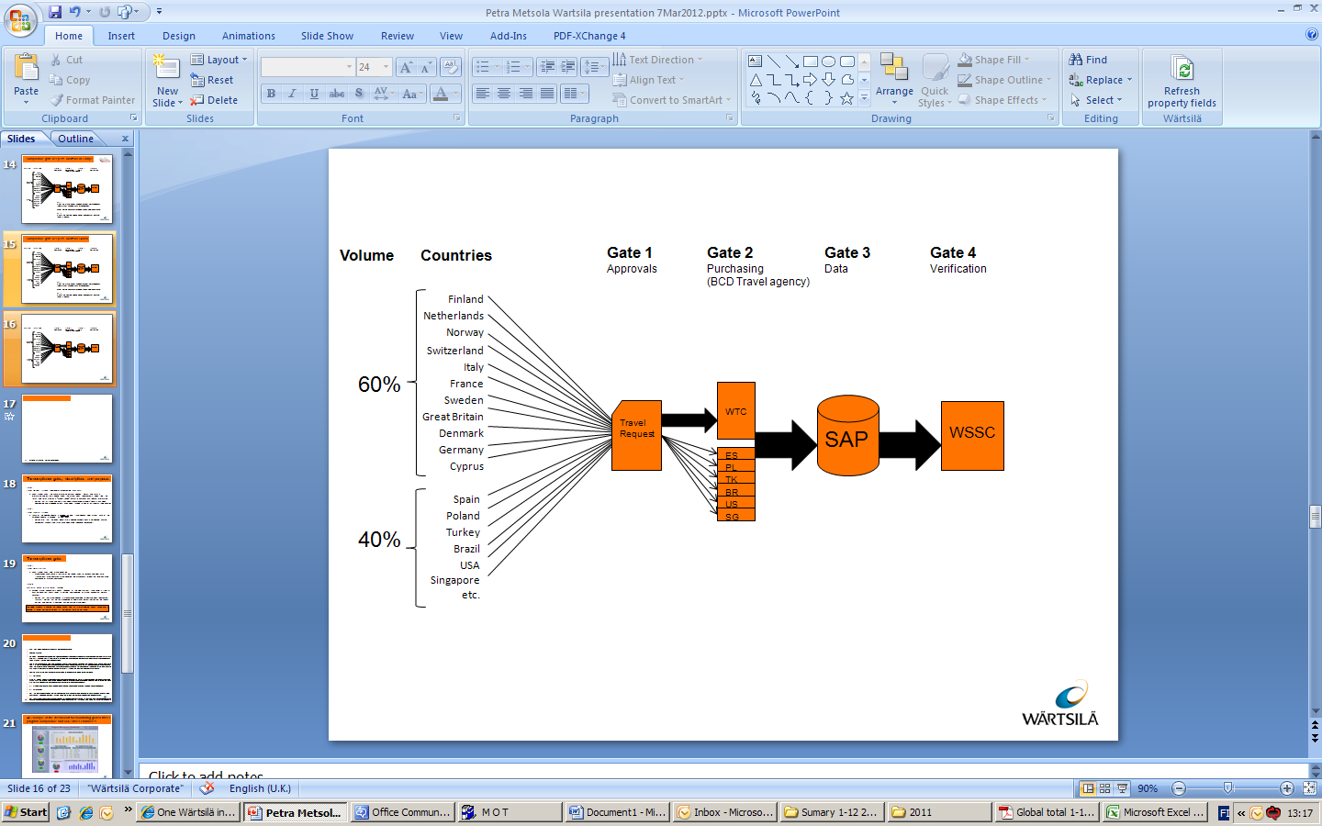
The compliance gates, descriptions and purposes
Gate1
Travel Request process (new eForm implemented May 2011)
  All trips has to be preapproved
  Trip type specifies the approval level
  Each traveller uses the same interactive eTravel Request Form.
  The form is informative and instructs people about the Travel Policy requirements when filling the form. The form creates a “mobile friendly” e-mail to approver with relevant information.
    Verifies that all travels and costs has been pre approved. Travellers’ security has been coordinated and all needed actions taken when travelling to high or extreme risk rated countries.

Slide 16
The compliance gates, descriptions and purposes
Gate 2
Travel Booking process
  100% of the booking volume is handled by one travel agency, BCD Travel. 93% of the European volume is handled by one team.
    Verifies e.g. that the lowest logical fare is booked, business class is not booked, Wärtsilä agreement suppliers and fares have been used (whenever reasonable).

Slide 17
The compliance gates
The compliance gates, descriptions and purposes
Gate 3
Travel Reporting tool
  Each traveller uses SAP Travel Reporting
    All companies have same structure of the receipt types, trip reasons and credit card transactions. One common Travel Reporting tool makes easy to follow the travel costs and compliance of all group companies.

Slide 18
The compliance gates, descriptions and purposes
Gate 4
Wärtsilä Shared Service Center (WSSC)
  WSSC’s Travel Accountants Team receives all the SAP (Gate3) travel reports from all Wärtsilä countries. Every report is verified and checked by Travel Accountant before payment.
    Verifies that the Travel Request is preapproved according to the Travel Policy requirement (Gate1). Verifies that the trips are booked by BCD Travel (Gate2). Verifies that the report is correct and content is compliant with the Wärtsilä Travel Policy.
This whole process is audited on regular bases also by Internal Auditing Team. When ever a loophole is found, corrective actions at the nearest gate will be taken.

Slide 19
Alternative for hotel bookings:
Wärtsilä’s hotel booking tool
Volume
Countries
Gate 1
Approvals
Gate 2
Purchasing
Gate 3
Data
Gate 4
Verification
Finland
Netherlands
Norway
Switzerland
Italy
France
Sweden
Great Britain
Denmark
Germany
Cyprus
WTC
60%
Travel Request
ES
SAP
WSSC
PL
TK
BR
US
SG
Spain
Poland
Turkey
Brazil
USA
Singapore etc.
Hotels
40%
Hotels
The other accepted way to make the hotel booking is to make it via our own hotel self booking tool.
24h/7
via internet
by telephone
by app in iPhone/Blackberry/Anroid
→ Global availability to Wärtsilä agreement hotels

Slide 20
Hotels and compliance
Booking channel compliance
  Accepted booking channels
    BCD Travel
    Wärtsilä’s hotel booking tool
      Some exceptions exist, e.g. service work (customer books and pays the hotel), trainings, conferences or other events when the organizer arranges the accommodation
  Cost compliance
    Max hotel cost/night is limited in travel policy

Slide 21
One process, fits all - Lessons learned
Top-management support is essential
Long term commitment needed
Cross functional cooperation
  Common targets for all functions
Clear and simple process
    The more exceptions the process has the more complicated it gets
Communications, communications, communications….

Slide 22
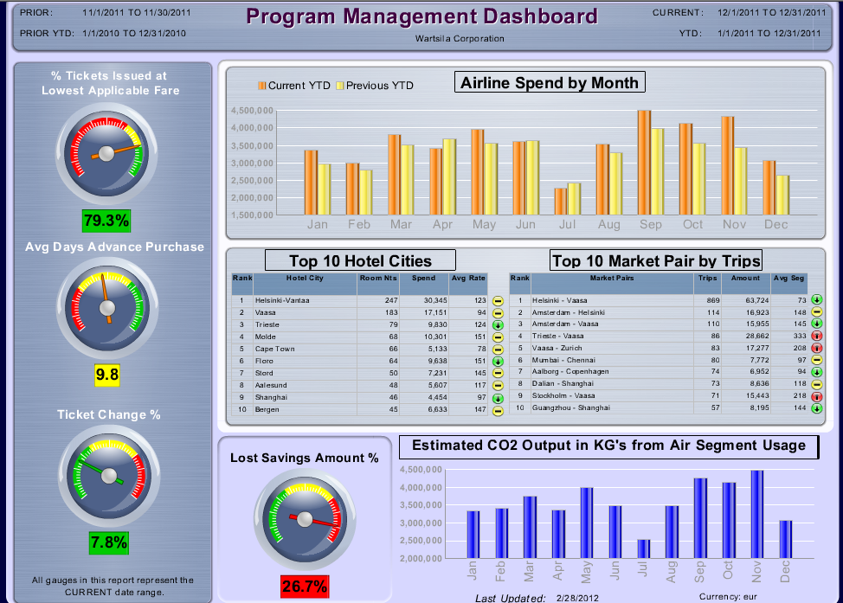
An example of the dashboard for monitoring global travel program compliance and BCD Travel Purchases
XXX
XXX

Slide 23
Questions, comments?

Slide 24


WARTSILA.COM
Petra Metsola
Category Manager Travel
Mob. + 358 (0)400 964 991
petra.metsola@wartsila.com
Notes:
24

